Slide 1
Water Technology
Hardness-definition, types of hardness and determination by EDTA method-numerical problems.
Determination of dissolved (DO) oxygen by Winkler’s method.
Biological Oxygen Demand (BOD)-definition, determination and numerical problems.
Chemical Oxygen Demand (COD)-definition, determination and numerical problems.

Slide 2
Types of water
Soft water : water that gives foam with the soap
Hard water : water that gives precipitate with the soap.
Hard water must be subjected for treatment to remove hardness by either physical method or chemical method
Physical methods : Reverse osmosis, distillation, ion exchange methods
Chemical Method: NaHCO₃ method

Slide 3
Hardness of water: Hardness of water is a property of water that measures of its capacity to precipitate soap. It gives the magnitude of the soluble salts present in water and responsible for making the water hard.
Types of hardness:
There are two types of hardness-
Temporary Hardness (Carbonate hardness): This type of hardness is due to dissolved bicarbonates of Ca and Mg. It can be removed by boiling.
For example:
Ca(HCO₃) ₂ ( in water) ( boil for 20 -30 minutes)----> CaCO₃ (ppt) + H ₂O + CO₂.
Permanent Hardness (Non- carbonate hardness): This type of hardness is due to soluble non-carbonate salts of Ca, Mg etc, namely, chlorides, nitrates, sulphates, hydroxides etc. They cannot be removed by heating. They need special chemical treatments to remove them.
A water sample may contain both types of hardness and hence,
Total Hardness = Temporary hardness + Permanent hardness

Slide 4
Units of Hardness of water:
Hardness of water is expressed in several ways
1. Parts per million (ppm):
It is the number of parts of calcium carbonate equivalent hardness per million (10⁶) parts of water
1 ppm = 1 part of CaCO₃ equivalent hardness in 10⁶ parts of water
2. Milligram per litre (Mg/L):
It is the number of milligrams of CaCO₃ equivalent hardness in 1 litre of water.
3. Degree of General Hardness (dGH or German degree): It is defined as 10 mg/L CaCO₃ or 17.848 ppm.
General classification of soft and hard waters: (mg/L or ppm)
a. Soft: 0 - 17.1
b. Slightly hard: 17.1 – 60
c. Moderately hard: 60 – 120
d. Hard: 120-180
e. Very hard: 180 and above.

Slide 5
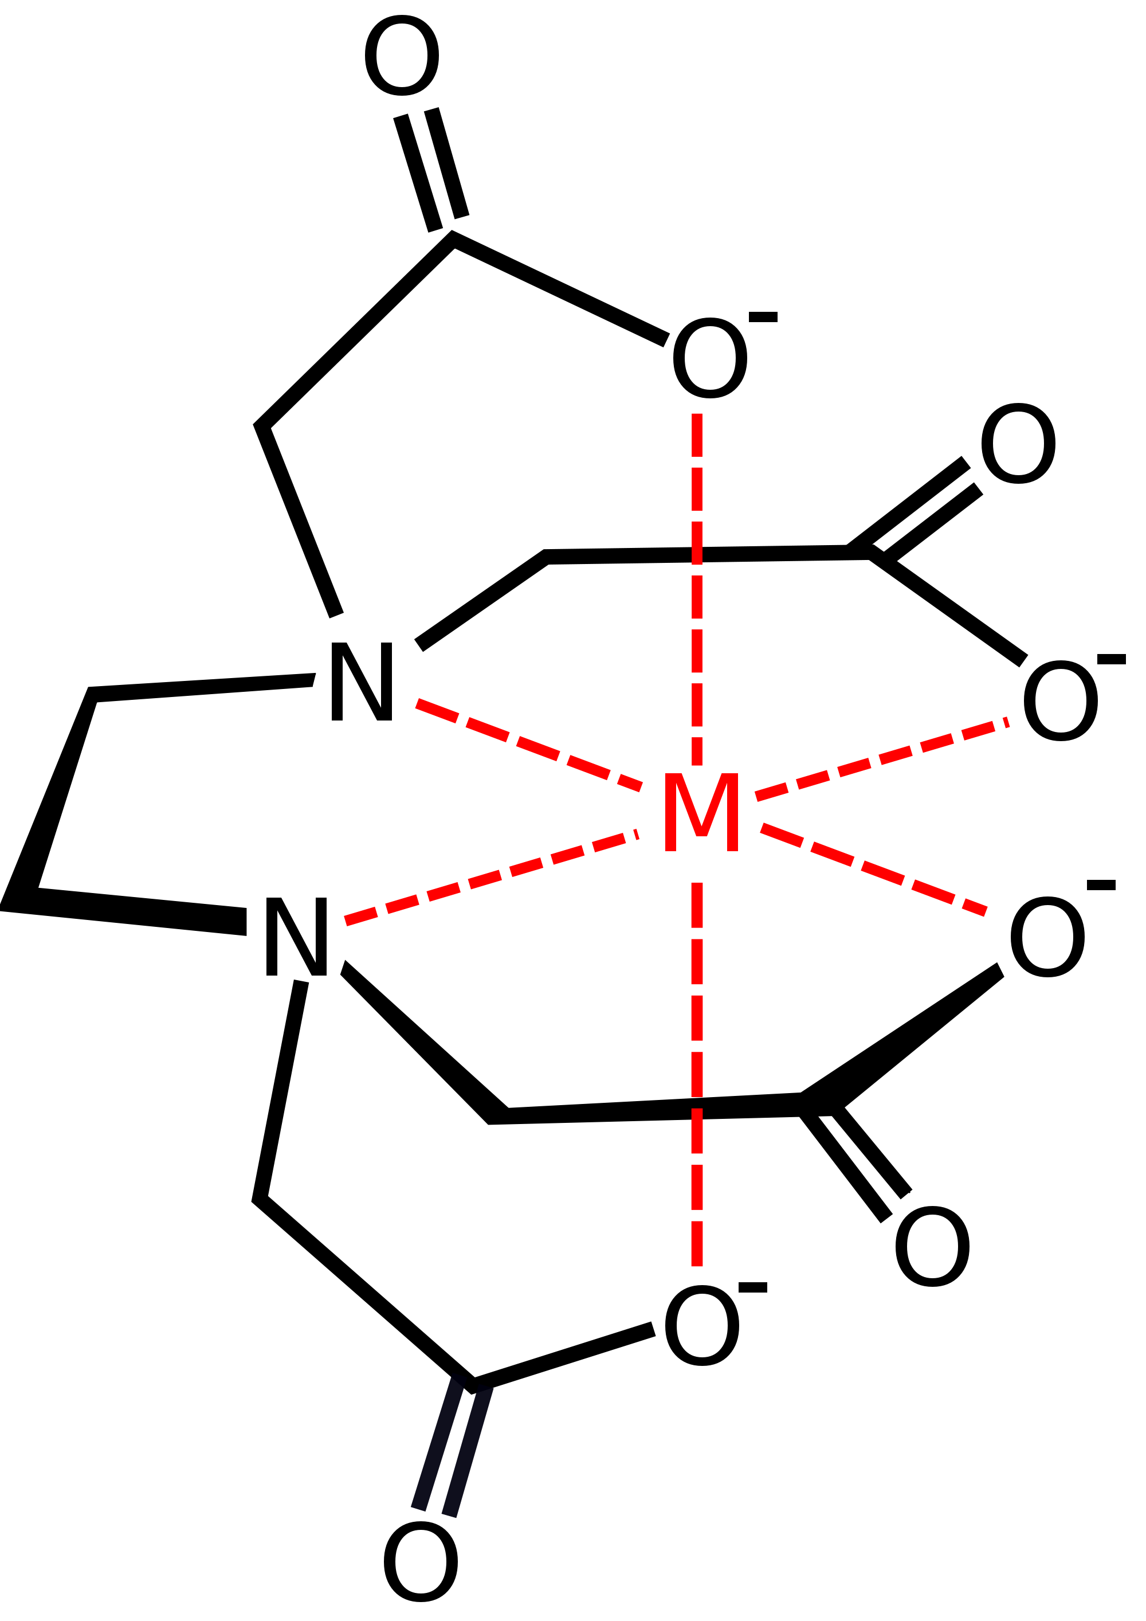
Determination of Hardness of Water (EDTA Method)
Principle: To a sample of hard water containing Ca or Mg salts, when the blue coloured Eriochrome Black-T (EBT) indicator is added at pH 10, it forms a wine-red complex with Ca or Mg ions. However, when it is titrated against a solution of EDTA, Ca and Mg ions from the Ca-EBT complex react with EDTA releasing free EBT which is blue in colour. By knowing the quantity of EDTA required it is possible to find the hardness of water
Ca²⁺ + EBT indicator (blue) ------> Ca-EBT complex (Wine red)
(in hard water)
Ca-EBT complex (wine red) + EDTA ----> [Ca-EDTA] + EBT
(Blue)

Slide 6
M²⁺
Disodium salt of EDTA
1:1

Slide 7
M
+
EBT
M-EBT
colorless
Blue
Wine red color
Std. EDTA
M-EBT
+
EDTA
M-EDTA
+
EBT
Wine red color
Colorless
Colorless
Blue
Hard water (M ions)
+ Buffer
+ EBT Indicator

Slide 8
Procedure:
Preparation of Std EDTA solution:
Dissolve a known wt. of soluble salt of EDTA in water in a 250 ml std. flask and add 2mL of ammonia, make up to the mark with water and mix well. Let its molarity be ‘x’ M.
Wt of EDTA salt x 4
Molarity =
Weight of the compound x 1000
‘X’ M =
Molecular weight of the compound x Volume
Mol. Wt of EDTA salt
a. Determination of Total hardness:
Pipette out 25 ml of the water sample in to a clean conical flask. Add 2 ml of NH₃- NH ₄Cl buffer and a pinch of EBT indicator. Titrate this against std. EDTA solution, until the colour changes from wine red to just blue. Notedown the volume of EDTA consumed, (say V₁ ml).

Slide 9
Calculations:
1000ml of 1 M EDTA = 100 g. of CaCO ₃
then
V₁ ml of ‘X’ M EDTA. =
V ₁ x X x 100
1000 x 1
= ‘A’ g. of CaCO ₃ in 25 ml water sample.
A
Total hardness =
X 10 ⁶ ⁼ D ppm of caco₃
25

Slide 10
b. Determination of Permanent Hardness:
Pipette out 25 ml of the same water sample in to a beaker, boil gently for 20-30 minutes, cool and filter in to a conical flask. To the filtrate add 2 ml NH ₃- NH ₄ Cl buffer and a pinch of EBT indicator. Titrate this against the same std. EDTA until the colour changes from wine red to just blue. Note the volume of EDTA consumed, say V₂ ml.

Slide 11
Calculations:
1000ml. of 1 M. EDTA = 100 g. of CaCO ₃
Then,V₂ ml of ‘X’ M EDTA. =
V₂ x X x 100
1000 x 1
= ‘B’ g. of CaCO ₃ in 25 ml boiled water sample.
B
∴ Permanent Hardness=
X 10 ⁶ ppm
25
c. Calculation of Temporary Hardness:
Total Hardness = Temporary hardness + Permanent Hardness
∴, Temporary hardness = Total hardness - Permanent hardness

Slide 12
Dissolved Oxygen Content and its determination:
Dissolution of atmospheric oxygen in water at its partial pressure is said dissolved oxygen content in water. Algae and rooted aquatic plants also give out oxygen in to water through photosynthesis.

Slide 13
Dissolved oxygen is required to survive the aquatic animals and also used for biological oxidation of the pollutants. But, oxygen being an oxidizing agent,hence, it causes corrosion of metallic structures in industry.
Excessive O₂ (Hyperoxia) : high corrosion of metal structures and oxidative stress in body by excessive O₂ ²⁻ radicals produced
Low O₂ (Hypoxia): high growth of unaerobic bacteria, foul smell, death of the aquatic animals

Slide 14
DO in water is determined by Winkler’s method.
Principle:
When a strong alkaline solution of MnSO₄ (divalent) is added to a water sample containing dissolved oxygen, it picks up oxygen to form basic MnO(OH)₂ ( tetravalent), that gives [O] in acidic medium ,which is used to oxidize KI to I₂. The liberated Iodine is found by titrating against a standard Na₂S₂O₃ thereby oxygen content is estimated.

Slide 15
MnSO₄ + 2 KOH ---------- > Mn (OH)₂ + K₂ SO₄
2Mn (OH )₂ + O₂ (Dissolved Oxygen)--- > 2 MnO (OH )₂
MnO (OH )₂ + H₂SO₄ ----- > MnSO₄ + 2H₂O + [O]
2 KI + H₂ SO₄ + [O] -------- > K₂SO₄ + H₂O + I₂
I₂ + 2 Na₂S₂O₃ -------------- > 2 NaI + Na₂ S₂ O₄

Slide 16
Procedure:
In a stoppered bottle, 300 ml of water sample is taken and add 3 ml MnSO₄, 3 ml alkaline KI. Now , Stopper the bottle and shake well for 10 to 15 minutes. Allow to stand for 2 minutes. Then add 1 ml conc. H₂ SO₄ and mix well to dissolve MnO₂ ppt and to liberate I_{2.}
300 ml water sample
3 ml MnSO₄
3 ml alkaline KI
Pipette out 100 ml of the above solution in to a conical flask and titrate against standard Sodium thiosulphate solution until the blue colour is just discharged .2 ml of starch solution as indicator added near the end point. Note the volume of Na₂S₂O₃ required (say V₁ ml).
1 ml conc. H₂ SO₄
I₂
100 ml

Slide 17
Std. Na₂S₂O₃
I₂ + 2 Na₂S₂O₃ -------------- > 2 NaI + Na₂ S₄ O₈
I₂
Sodium
Iodide
Sodium
dithionite
Starch as
an indicator

Slide 18
Calculations:
Volume of water sample taken = V₂ ml,
Volume of Na₂S₂O₃ = V₁ ml
Normality of Na₂S₂O₃ = N₁
Normality of D.O in water = N₂
Volume of water sample taken = 100 ml
Volume of Na₂S₂O₃ consumed = V₁ ml
Normality of Na₂S₂O₃ used = N₁
Na₂S₂O₃
D. O in water
N₁V₁ = N₂V₂
N₂ = (N₁ X V₁)/ V₂
now, weight of D.O in mg = N _{B} X Eq. wt of O₂ x1000 = D₁ mg O₂ /dm³
⸪ Wt. = Normality x Equivalent wt of the compound

Slide 19
BOD
COD
BOD is only measurement of consumed oxygen by aquatic microorganisms to decompose or oxidize organic matter.
COD refers the requirement of dissolved oxygen for the oxidation of both organic and inorganic constituents

Slide 20
Determination of BOD in waste water (Winkler’s Method)
Dissolved oxygen cannot be directly estimated by volumetric titration since oxygen does not react with sodium thiosulfite. However, as oxygen being an oxidizing agent ,it must need to be estimated in an indirect way.i.e winkler’s method
Biological Oxygen Demand (B.O.D)
Sewage water contains a lot of organic pollutants which undergo anaerobic oxidation to give products with stinking smell. Such waste water requires oxygen for the oxidation.
Definition: “The amount of oxygen required in milligrams for the biological oxidation of organic matters under aerobic condition, present in one liter of waste water over an incubation period of five days at 20º C, is called biological oxygen demand”.
Oxygen present in water is capable of oxidizing the biologically oxidizable pollutants, with the help of bacteria and in this way the oxygen in water is consumed.

Slide 21
Determination of B.O.D:
Principle: When a sample of water containing dissolved oxygen is treated with MnSO₄ and alkaline KI solutions, dissolved oxygen oxidizes Mn²⁺ to Mn⁴⁺. On acidification Mn⁴⁺ liberates I₂ from KI which is estimated by standard Na_{s}S₂O_{3.} By determining the dissolved O₂ content in water before and after incubation period it is possible to find B.O.D
Procedure:
a) Preparation of Two separate diluted waste water sample: Pipette out a known volume of sewage water sample (‘A’ ml) and dilute it to a known volume (‘B’ ml) by adding dilution water containing free oxygen and nutrients. Fill in two bottles.
‘A’ ml
‘B’ ml
1
2

Slide 22
b) Blank titration: In bottle -1 find D.O immediately as follows: Add 3 ml MnSO₄ + 3 ml alkaline KI. Stopper the bottle and mix well for 10-15 minutes. Wait for 2 minutes and then add 1 ml conc. H₂SO₄ to dissolve MnO₂ ppt and to liberate I₂. A known volume of this solution (‘V’ ml) is titrated against std. Na₂S₂O₃ using 2 ml of starch as indicator near the end point. Note the volume of Na₂ S₂O₃ required (say V₁ ml).
Std. Na₂S₂O₃
1
I₂ + 2 Na₂S₂O₃ -------------- > 2 NaI + Na₂ S₂ O₄
I₂
Starch as
an indicator
Sodium
Iodide
Sodium
dithionite

Slide 23
c) Back/sample titration: Bottle -2 is incubated at 20º C for 5 days . After 5 days, add 3 ml MnSO₄ + 3 ml alkaline KI. Stopper the bottle and mix well for 10-15 minutes. Wait for 2 minutes and then add 1 ml of conc. H₂ SO₄ to dissolve MnO₂ ppt and to liberate I₂. Pipette out same known volume of this solution (‘V’ ml) and titrate against the same std. Na₂S₂O₃ as above. Note the volume Na₂ S₂O₃ required (say V₂ ml).
Std. Na₂S₂O₃
Incubated
for 5 days
at 20º C
2
I₂ + 2 Na₂S₂O₃ -------------- > 2 NaI + Na₂ S₂ O₄
I₂
Starch as
an indicator
Sodium
Iodide
Sodium
dithionite

Slide 24
Calculations:
1) D.O from Blank titration:
Volume of water sample taken = 100 ml,
Volume of Na₂S₂O₃ = V₁ ml
Normality of Na₂S₂O₃ = N₁
Normality of D.O in water = N _{B}
N _{B} = (N₁ X V₁)/ 100
now, weight of D.O in mg = N _{B} X Eq. wt of O₂ x1000 = D₁ mg O₂ /dm³

Slide 25
2) D.O from back /sample titration: [bottle-2]
Volume of water sample = 100 ml,
(After 5 days)
Volume of Na₂S₂O₃ = V₂ ml.
Normality of Na₂S₂O₃ = N₁
Normality of D.O in bottle -2= (N₁ V₂)/100 = N_{S}. Normality of DO in bottle-2 after 5 days over
weight of D.O in mg = N_{s} X Eq. Wt of O₂ x 1000 = D_{2.} mg/dm³
Therefore, B.O.D of the sample = (D₁- D₂) (B/A) =…Z……mg O₂ dm⁻³

Slide 26
Chemical Oxygen Demand (C.O.D)
Effluent coming out of domestic and industrial areas contain both biologically oxidizable organic pollutants and chemically oxidizable organic and inorganic pollutants. For oxidation of such pollutants a strong oxidizing agent such as K₂ Cr₂ O₇ which can release a large amount of oxygen is required.
Definition: “The amount of oxygen in milligrams used in the chemical oxidation of biologically oxidizable, organic and inorganic pollutants in presence of acidified K₂ Cr₂ O₇,present in one liter of waste water is called chemical oxygen demand”.
COD gives the total oxidizable impurities including biologically oxidizable, and chemically oxidizable organic and inorganic matters in the sewage.

Slide 27
Determination of C.O.D:
Principle:
A known volume of waste water sample is taken and refluxed with a known quantity of K₂Cr₂ O₇ solution in H₂SO₄ in presence of Ag₂ SO₄ (to catalyze the oxidation of straight chain organic compounds) and Hg SO₄ (to avoid the interference of chloride by forming a soluble complex). The amount of K₂ Cr₂O₇ unconsumed is titrated and there by calculated consumed K₂ Cr₂O₇ Which corresponds to C.O.D of the sample.
K₂Cr₂O₇
Ag₂ SO₄
Hg SO₄
F. A. S
Organic and Inorganic
K₂Cr₂O₇
To know remaining K₂ Cr₂O₇
silver sulfate (Ag2 SO4 ) as a catalyst, and mercuric sulfate (HgSO4 ) added to remove interference of chlorides.

Slide 28
Procedure:
Preparation of Std. F.A.S solution: Dissolve a known weight of F.A.S in water with a few mL of dil.H₂SO₄ in a 250 ml Std. volumetric flask and make up to the mark with water and mix well.
Let its Normality be
Normality =
Wt. of F.A.S x 4
Molarity =
Weight of the compound x 1000
Equivalent wt. of F.A.S
Molecular weight of the compound x Volume
F.A.S
dil.H₂SO₄
250 ml

Slide 29
b) Back Titration: A known volume of waste water sample is taken (V) ml in to a conical flask and 1 g. of Ag₂ SO₄ and 1 g. of Hg SO₄ are added, followed by a known volume of K₂Cr₂O₇ acidified by H₂SO₄. The solution is refluxed for 20-30 min. Cooled and filtered. The filtrate is titrated against a standard FAS solution using ferroin as indicator. The colour changes of this titration is from bluish green to reddish brown color .Note the volume of F.A.S required (say, Bml).
Ferroin
[Fe]²⁺
^{Reddish Brown}
Std. F.A.S
K₂Cr₂O₇
Ag₂ SO₄
Hg SO₄
End point- Bluish green to reddish brown
K₂Cr₂O₇
Organic and Inorganic
Ferroin
[Fe]³⁺
^{Bluish Green}
K₂Cr₂O₇
K₂Cr₂O₇
F. A. S
To know remaining K₂ Cr₂O₇

Slide 30
c) Blank titration: The above procedure is repeated by taking the same volume of distilled water instead of waste water sample. Note the volume of FAS required after titration (say, C ml)
K₂Cr₂O₇
Ag₂ SO₄
Hg SO₄
No waste water
(No Organic and Inorganic)
K₂Cr₂O₇
F. A. S
To know remaining K₂ Cr₂O₇

Slide 31
Calculations:
Volume of waste water sample taken = 25 mL
Normality of FAS used = N _{FAS}
Volume of F.A.S consumed in back titration = B mL
Volume of F.A.S consumed in blank titration = C mL
So, the volume of K₂ Cr₂O₇ consumed in terms of ‘volume ‘of FAS = (C – B) mL
Therefore, normality of oxygen in waste water N₁ = [(C-B )/V] x N _{FAS}
The C.O.D of the sample = N₁ x Equiv. wt. of Oxygen in mg.
= N₁ x 8 x 1000 = …Y…. mg dm⁻³
Volume of FAS x Normality of FAS
N₁ =
Volume of waste water sample(25mL)

Slide 32
Argentometric titration (Cl⁻ estimation)[Experiment 5 in Lab course]
https://drive.google.com/file/d/14a333YXP_8NSxKVPCvuGhDjZ9ZBHZrII/view?usp=sharing
Sources Chloride in water : soluble salts MgCl ₂ , CaCl ₂ , KCl etc
Problems associated with Cl⁻ water : Metallic corrosion of structures , Harmful effects in agriculture..
Principle:
pH =7
Cl⁻ ( in water) + AgNO₃ → AgCl (↓) + NO₃⁻
K₂CrO₄ + 2 AgNO₃ (excess) → Ag₂CrO₄ (↓) + 2 KNO₃
(Yellow ) ( brick red)

Slide 33
Procedure:
Burette : standard AgNO₃ solution
Conical Flask : 100 ml the water sample(neutral pH) in to a conical flask ,
Indicator : 2-3 drops of potassium chromate
Colour changes : yellow ( CrO₄ ²⁻ ion ) to brick red tinge (Ag₂CrO₄ )
Note the volume of AgNO₃ consumed, V₁ ml.
Calculations:
Volume of water taken =100 ml,
Volume of AgNO₃ = V₁ ml
Concentration of AgNO₃ = N₁
Normality of Chloride in water=
( N ₁ X V₁/100) = N₂
Hence, weight Chloride content in water in mg
= N₂ X 35.5 X 1000 = ……..mg dm⁻³

Slide 34
Spectro photometric Determination of NO₃⁻
Sources of NO₃⁻ in water : synthetic fertilizers , decay of animal and vegetables
Problems associated with excess NO₃⁻ Water :
Bitter in taste
causes many physiological disorders like gastrointestinal cancer, Alzheimer,
Reduces oxygen carrying capacity of blood ,
Blue-baby syndrome.

Slide 35
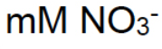
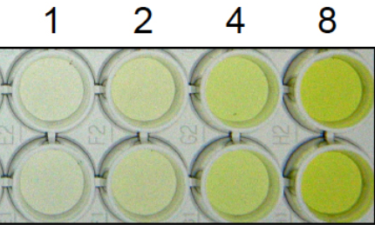
Determination of Nitrate
Principle:
NO₃⁻ reacts with Phenol di sulfonic acid (PDA) to give a nitro derivative in alkaline solution, which is yellow in colour.
The yellow colour intensity is proportional to the concentration of NO₃⁻ in sample. a\c to Beer’s law.
A=log 1/T =ɛ Ct
A=absorbance (or)optical density of nitrate ,
^{T =transmittance} ,
C= concentration of nitrate,
t = thickness of cell

Slide 36
Preparation of a Known conc of NO₃⁻ solutions for the Calibration curve:
Take 5, 10, 15, 20 and 25 ml of 0.1N of KNO₃ standard solution in 5 separate 50 ml beakers and evaporate to dryness.
Add 2 ml PDA solution and Add 10 ml conc. NH₃ to each beaker and dissolve the residue which is quantitatively transferred into a separate 100 ml standard volumetric flasks , dilute up to the mark with distilled water and mix well.
In the same manner , water sample solution is prepared.
Blank solution is prepared by taking 10mL NH₃ and 2mL PDA solution in the another 100ml Volumetric flask and dilute it upto the mark with distilled water.
Measure the absorbance or optical density of the prepared solution at 410 nm wave length by colorimeter.
Plot the graph of absorbance Vs concentration of NO₃⁻ and find out conc of NO₃⁻ in the water sample.

Slide 37
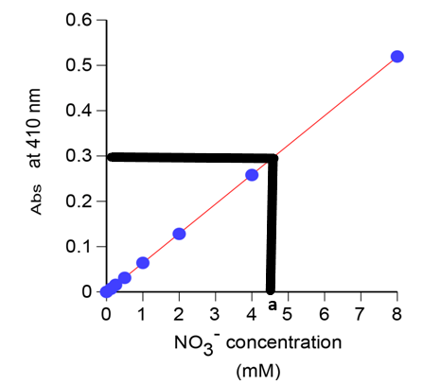
Calculation
Volume of KNO₃ | Concentration of NO³⁻ [VX(62/101)X 6X 10⁻³ ] | OD/Absorbance
5
10
15
20
25
30
Water sample(a) |  | b
6 g of KNO₃ salt dissolves in 1000mL of water as a stock solution
101 g of KNO₃ contains = 62 g of nitrate
6 g of KNO₃ contains = (62/101)X 6 g of nitrate in 1000mL of KNO₃ solution
1mL of KNO₃ solution contains = (62/101)X 6 X 10⁻³ g of nitrate
Result:
‘a’ value on the X-axis corresponds to the concentration of Nitrate in the water sample.

Slide 38
What is temporary and permanent hardness of water? Explain the determination of total hardness of water by EDTA method.
Discuss the determination of chloride by argentometric method
Define BOD and COD. Why is COD higher than BOD?
What is hard water? What are the causes for hardness of water and why CaCO₃ is used to express the hardness of water?
What is potable water? Explain the method of desalination of hard water by reverse osmosis method.
Explain the method of determining nitrate content in water using spectrophotometer.
Explain the gravimetric method of determination of sulfate content in water.
Describe the Winkler’s method of the determination of dissolved oxygen in water
Write note on reverse osmosis

